Slide 1
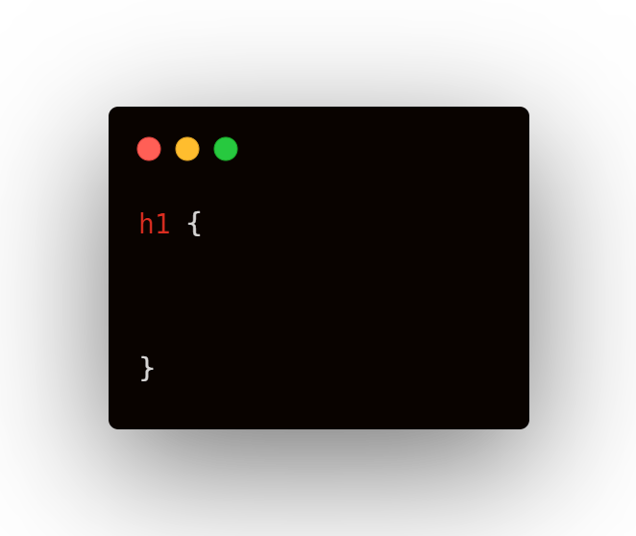

CSS Box Model Simplified
Hey Twitter!

Slide 2
CSS Box Model Simplified
Hey Twitter!
margin: 24px

Slide 3
CSS Box Model Simplified
Hey Twitter!
margin: 22px
padding: 10px

Slide 4
CSS Box Model Simplified
Margin
Hey Twitter!
margin: 22px
padding: 10px

Slide 5
CSS Box Model Simplified
Border
Hey Twitter!
margin: 22px
padding: 10px

Slide 6
CSS Box Model Simplified
Padding
Hey Twitter!
margin: 22px
padding: 10px

Slide 7
CSS Box Model Simplified
Content
Hey Twitter!
margin: 22px
padding: 10px

